Slide 1

Sync+ 2.0
CX483MCA–Desay_EESE&CVPP parts
China EESE&CVPP
Updated on 2022-10-25
Desired Outcome
Awareness
Decision
Escalation Help
Think
Point of view
Plan to Implement
Implement

Slide 2
{R06.1 PRO HF1} Software overall status {yellow}
Software key info
  Refer SWAD for the details:
    MCU version:20220919_531_PRO
    SOC version:20221012_0808_KL27_R06.1.PRO.HF1_User
  Verification scope and method:
    {Full verification} executed with pass rate 97.42%, 0P1 and 43P2 issues found and not fixed. Refer test report for detail.
Main changes compared with previous version, refer RN for the details, highlights listed below:
    Release note– refer slide 3
    Open P2 issue list with risk evaluation – refer slide 4
    Performance status– refer slide 5-7
    OTA status– refer slide 8
Notes:
Add P1 weekly burn down chart

Slide 3
{R06.1 PRO HF1} Release note
Key | Summary | Priority | 验证结果 | Remark
AW2-7635 | [CX483MCA][高概率复现][setting]点击左侧的常驻栏和调节空调温度动效都会出现花屏 | Immediate Gating | pass | Root cause：合入高通给的用修复蓝屏的白屏的DRM的patch 导致此问题。 压测结果：台架500次压测，均无花屏

Slide 4

{R06.1 PRO HF1} Open P2 issue list with risk evaluation
计数项:Fix Version/s2 | 列标签
行标签 | KL27_R06.ENG2 | KL27_R06.PRO | KL27_R07.ENG2 | KL27_R07.PRO | (空白) | KL27_R06.1.PRO | 总计
Analysis | 1 | 1 |  | 6 | 17 |  | 25
Developing |  |  |  |  | 1 |  | 1
Verification |  |  | 8 | 8 |  |  | 16
ready |  |  |  |  |  | 1 | 1
总计 | 1 | 1 | 8 | 14 | 18 | 1 | 43
1.10-24 新增12个，在分析中，预计本周内有分析结论
Notes:
Add P1 weekly burn down chart

Slide 5
{R06.1 PRO HF1} 性能状态
R06.1 PRO HF 优化的性能
1、优化精简屏幕热启动时间
2、优化蓝牙电话热启动时间
3、 优化Monkey test com.desay.setting crash 、ANR、AndroidRuntime问题
4、优化mokey test 中内存泄漏的问题
R07性能优化方向：
1.Launcher显示到优先蓝牙重连完成的时间，默认音源USB音乐
2.Power on优先设备BT音源恢复的时间
3.Power on车辆设置界面打开的时间
4.Monkey性能的优化
Notes:
Add P1 weekly burn down chart

Slide 6
{R06.1 PRO HF1} 性能测试状态
类别 | 序号 | 影响因素 | 权重 | R04.HF2 | R05 | R06 | R06.1 | CD542H R11 | R06.1 Target | 允许偏差上限 | 偏差 | 评分 | 得分 | 分析 | Test Result
响应时间 | 1 | Power on第一帧动画播放 | 1 | 8.20 | 8.51 | 8.92 | 8.89 | 10.05 | 9.6 | 10.6 | -7.38% | 4 | 4 |  | Pass
响应时间 | 2 | Power on到Fast RVC显示 | 1 | 7.47 | 7.51 | 8.91 | 8.86 | 8.94 | 9 | 10 | -1.59% | 4 | 4 |  | Pass
响应时间 | 3 | Power on Launcher界面可见 | 1 | 23.52 | 25.31 | 24.41 | 24.02 | 20.25 | 24 | 25.2 | 0.09% | 3 | 3 |  | Pass
响应时间 | 4 | Launcher显示到优先蓝牙重连完成，默认音源USB音乐 | 1 |  |  | 9.76 | 10.16 | 10.37 | 10 | 10.5 | 1.58% | 1 | 1 | 确认用安卓手机连接 | Pass
响应时间 | 5 | Power on车机网络时间同步完成 | 0.5 |  | 12.23 | 11.47 | 11.23 | 12.06 | 18.8 | 19.74 | -40.28% | 5 | 2.5 | 开机到log打印时间 | Pass
响应时间 | 9 | 开机动画过程中到Fast RVC显示 | 1 |  |  | 1.60 | 1.19 | 1.08 | 1.5 | 1.8 | -20.73% | 5 | 5 |  | Pass
响应时间 | 10 | Power on Launcher启动后Fast RVC显示 | 2 | 1.73 | 1.15 | 1.71 | 1.29 | 1.24 | 1.5 | 1.8 | -13.73% | 4 | 8 |  | Pass
响应时间 | 11 | Power on优先设备BT音源恢复 | 1 | 11.61 | 12.00 | 11.18 | 12.08 | 9.8 | 18.00 | 18.90 | -32.88% | 5 | 5 |  | Pass
响应时间 | 15 | Power on车辆设置界面打开 | 0.5 | 5.01 | 3.88 | 3.65 | 3.71 | 2.08 | 5 | 5.75 | -25.73% | 5 | 2.5 |  | Pass
响应时间 |  | 空调设置界面打开 | 0.5 | 4.60 | 2.70 | 0.61 | 1.31 | 0.34 | 2 | 2.4 | -34.52% | 5 | 2.5 |  | Pass
响应时间 | 16 | Power on点击空调按钮可用 | 0.5 | 4.60 | 3.86 | 1.65 | 1.00 | 1.27 | 1.5 | 1.8 | -33.49% | 5 | 2.5 |  | Pass
响应时间 | 32 | Launcher显示到进入稳定运行阶段经过的时间 | 2 | 65.13 | 49.40 | 47.68 | 44.95 | 43.85 | 50 | 50 | -10.10% | 4 | 8 |  | Pass
响应时间 | 33 | 系统稳定状态下Setting首次启动 | 0.5 | 1.90 | 0.95 | 1.58 | 1.44 | 0.9 | 2.2 | 2.64 | -34.48% | 5 | 2.5 |  | Pass
响应时间 | 36 | 系统稳定状态下蓝牙音乐首次启动 | 1 | 2.22 | 2.21 | 2.60 | 2.73 | 1.9 | 4 | 4.6 | -31.68% | 5 | 5 |  | Pass
响应时间 | 37 | 系统稳定状态下FM首次启动 | 1 | 3.73 | 2.60 | 1.57 | 2.16 | 1.03 | 4 | 4.6 | -45.88% | 5 | 5 |  | Pass
响应时间 | 39 | Setting热启动 | 1 | 1.09 | 0.57 | 0.58 | 0.60 | 0.66 | 0.6 | 0.78 | -0.47% | 4 | 4 |  | Pass
响应时间 | 42 | 蓝牙音乐热启动 | 1 | 0.19 | 1.09 | 1.18 | 0.93 | 0.47 | 1.00 | 1.20 | -6.83% | 4 | 4 |  | Pass
响应时间 | 43 | FM热启动 | 1 | 1.43 | 1.12 | 0.72 | 0.73 | 0.35 | 1 | 1.2 | -26.70% | 5 | 5 |  | Pass
响应时间 | 67 | air conditioner热启动时间 | 0.5 | 0.24 | 0.22 | 0.21 | 0.25 | 0.25 | 0.3 | 0.39 | -15.11% | 4 | 2 |  | Pass
响应时间 | 71 | 蓝牙电话恢复时间 | 0.5 | 10.88 | 9.89 | 9.65 | 10.45 | 9.62 | 10.00 | 10.50 | 4.53% | 3 | 1.5 |  | Pass
响应时间 |  | 蓝牙电话冷启动时间 | 1 |  |  | 1.96 | 1.39 | 1.34 | 3.00 | 3.45 | -53.63% | 5 | 5 |  | Pass
响应时间 | 72 | 蓝牙电话热启动时间 | 0.5 | 0.51 | 0.36 | 0.72 | 0.57 | 0.46 | 0.50 | 0.65 | 13.67% | 3 | 1.5 |  | Pass
响应时间 | 73 | 投屏冷启动时间 | 0.5 | 1.63 | 1.87 | 1.55 | 1.17 | 0.4 | 1.5 | 1.8 | -22.20% | 5 | 2.5 |  | Pass
响应时间 | 77 | 精简屏幕冷启动时间 | 0.5 | 1.44 | 1.62 | 1.32 | 1.28 | 1.44 | 1.5 | 1.8 | -14.84% | 4 | 2 |  | Pass
响应时间 | 78 | 精简屏幕热启动时间 | 0.5 | 1.39 | 0.49 | 1.08 | 0.48 | 0.46 | 1 | 1.2 | -52.17% | 5 | 2.5 |  | Pass
Notes:
Add P1 weekly burn down chart

Slide 7
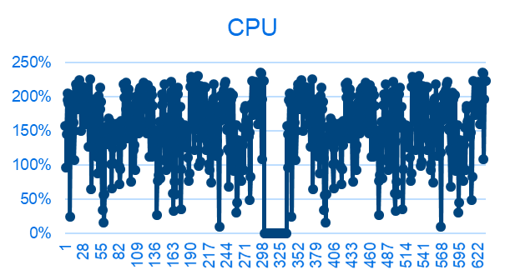
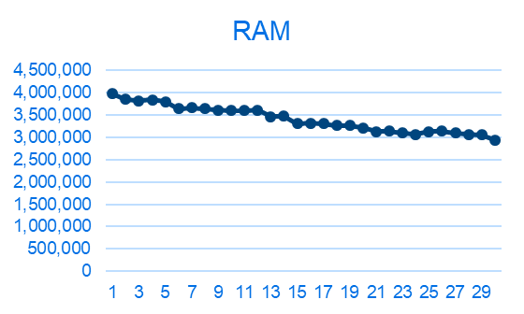
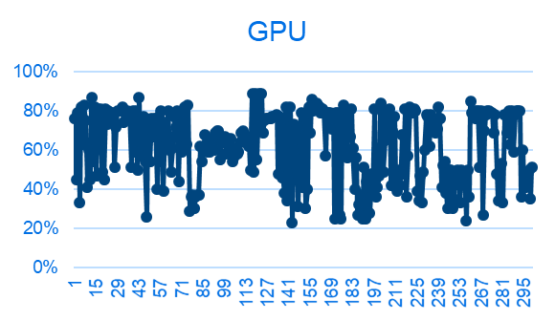
{R06.1 PRO} 性能状态
序号 | 影响因素 | 权重 | R05 | R06 | R06.1 | 分析
1 | 24小时Monkey中的ANR次数 | 1 | 1 | 3 | 3 | com.desaysv.mediaplayer、 Root cause:蓝牙音乐操作数据库发生ANR com.android.systemui、 SystemUI主线程查询ID3数据库导致ANR com.desay_svautomotive.radioapp Root cause:频繁读写数据库导致的阻塞 Fix version:R07 PRO 优化改善
2 | 24小时Monkey中的Crash次数 | 1 | 1 | 1 | 1 | com.desay_svautomotive.radioapp Root cuase: 多线程修改list数据导致的ConcurrentModificationException Fix version：R07 PRO 优化改善
3 | 24小时Monkey中内存泄露进程数 | 1 | 2 | 1 | 1 | Root case：加载bitmap 和粒子动效的时候没有释放 Fix version:R07 PRO 优化改善
4 | 8小时Monkey测试-设置 | 0.5
5 | 8小时Monkey测试-蓝牙音乐 | 0.5
6 | 8小时Monkey测试-蓝牙电话 | 0.5
CPU Free
RAM Free
GPU Free
Notes:
Add P1 weekly burn down chart

Slide 8
{R06.1 PRO HF1} OTA测试状态
Title: | Verification Test Report For OTA
Function Name | Total Test Case | Passed Test Case | Failed Test Case | Percentage of Test Completion: | Test Cases Pass Percentage:
TC_SOC_OTA | 86 | 76 | 0 | 88.37% | 100.00%
TC_MCU_OTA | 74 | 71 | 0 | 95.95% | 100.00%
TC_MCU_USB | 66 | 65 | 0 | 98.48% | 100.00%
TC_SOC_USB | 66 | 65 | 0 | 98.48% | 100.00%
Total | 292 | 277 | 0 | 94.86% | 100.00%
R06.1 PRO HF1版本冒烟测试结果Pass
Notes:
Add P1 weekly burn down chart

